Slide 1
LONDON
21st November, 2024
ISC2.org/Events | #ISC2Events
Building "Role Governance as Code" Solution.
Lessons Learned.
Kir Bogdanov, CISSP

Slide 2

Agenda:
Where did it start?
2 types of identities
Are all the roles made equal?
What is role lifecycle?
What about workload identities?
Solution overview

Slide 3

Where did it start?

Slide 4

2 types of actors
Human actors
Users, Administrators, Support
Interactive access
Portals
CLI
Machine actors
Pipelines, tools, services
API access
Fixed set of instructions

Slide 5



Human actors
Niche use cases
Activity Monitoring
Just enough / just in time

Slide 6



Are all the roles made equal?
Non privileged roles
Control plane only
Read access
Low blast radius
Privileged roles
Write/Change access
No/restricted access to data plane
Requires hardening
Superpower
Full control
Ability to change roles and controls
Data plane access
Require privileged session management

Slide 7
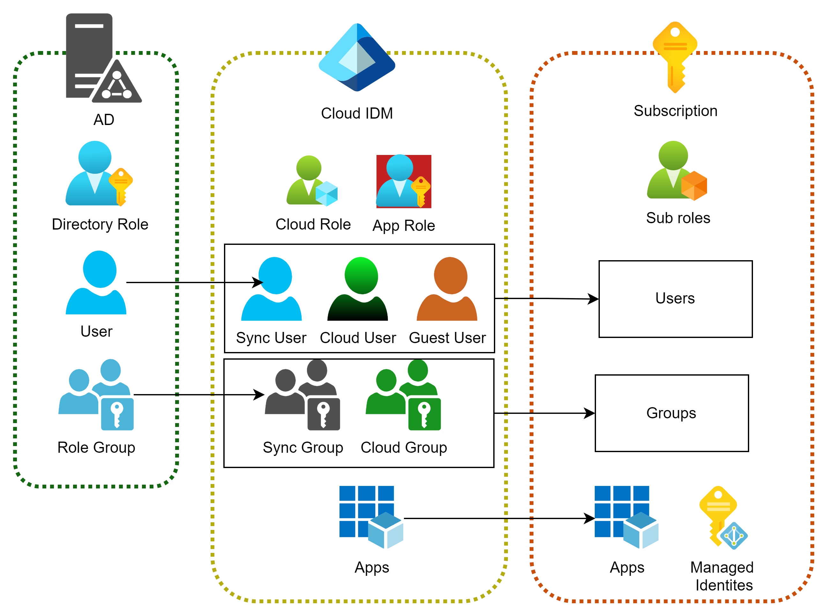
Variety of roles and objects
Good old Active Directory. Directory roles, users, security groups
Cloud Identity store. Cloud specific roles, App specific roles, users, groups, service principals
Cloud RBAC . Subscription specific roles. Environment specific service principals

Slide 8
Role assignment lifecycle
Add
Assign
Recertify
Remove Assignment
Remove role
Security and Compliance responsibility
Roles’ lifecycle
Assignment supervision
Application teams’ responsibility
Assignments’ lifecycle
Recertification

Slide 9
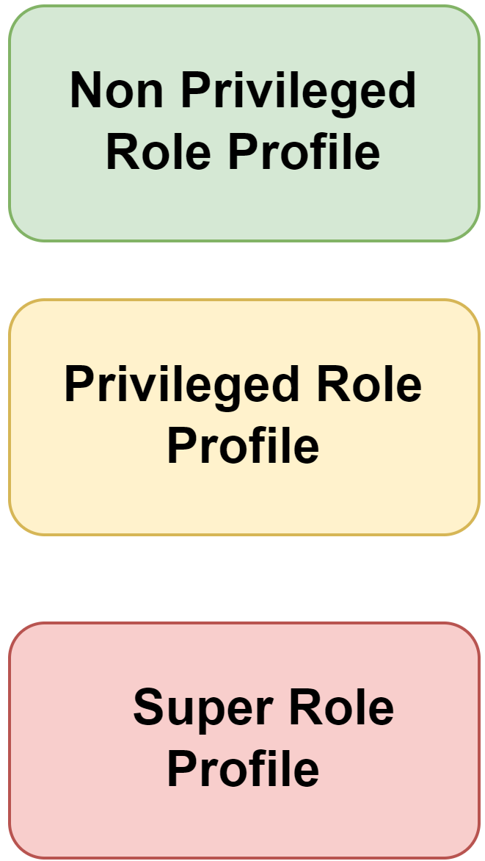
Solution: Setting guardrails
Role Inventory
Role 1
Role 2
Role 3
Role 4
Role 5
Team Configuration:
Approvers
Scopes
Custom roles:
Permissions
Inventory data
Team’s approved roles

Slide 10



Solution: Delegating assignments
Approve
Remove
Review
R
Entitlement
Role
User
One role >
Multiple Packages >
Multiple delegates
Team manager

Slide 11

What about workload identities?

Slide 12



Workload Identities types
Registered App
Manually created
Cloud IDM control plane
Can be referenced in Cloud Infrastructure RBAC
System managed identity
Automatically created with a resource
One service instance = one identity
Enabled in Cloud Infrastructure control plane
User managed identity
Manually created within a subscription
May be linked to multiple resources
Managed through Cloud Infrastructure control plane

Slide 13


Solution: Delegating within subscriptions
Deployment pipeline:
Assign roles to workloads only
Except prohibited
Subscription
Prohibited roles
Team config:
Subscriptions
SP ID
Resource
Identity
Role
IaC

Slide 14
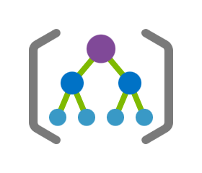
Solution: Managing Environment roles
Root Management Group
Roles List
Roles Assignments:
Role
SP ID
Scope
Date
Reason
Role Assignments

Slide 15

Recertification
Access Reviews
Automatic provisioning
Based on configuration

Slide 16
Solution overview
Let’s try to get it all together

Slide 17
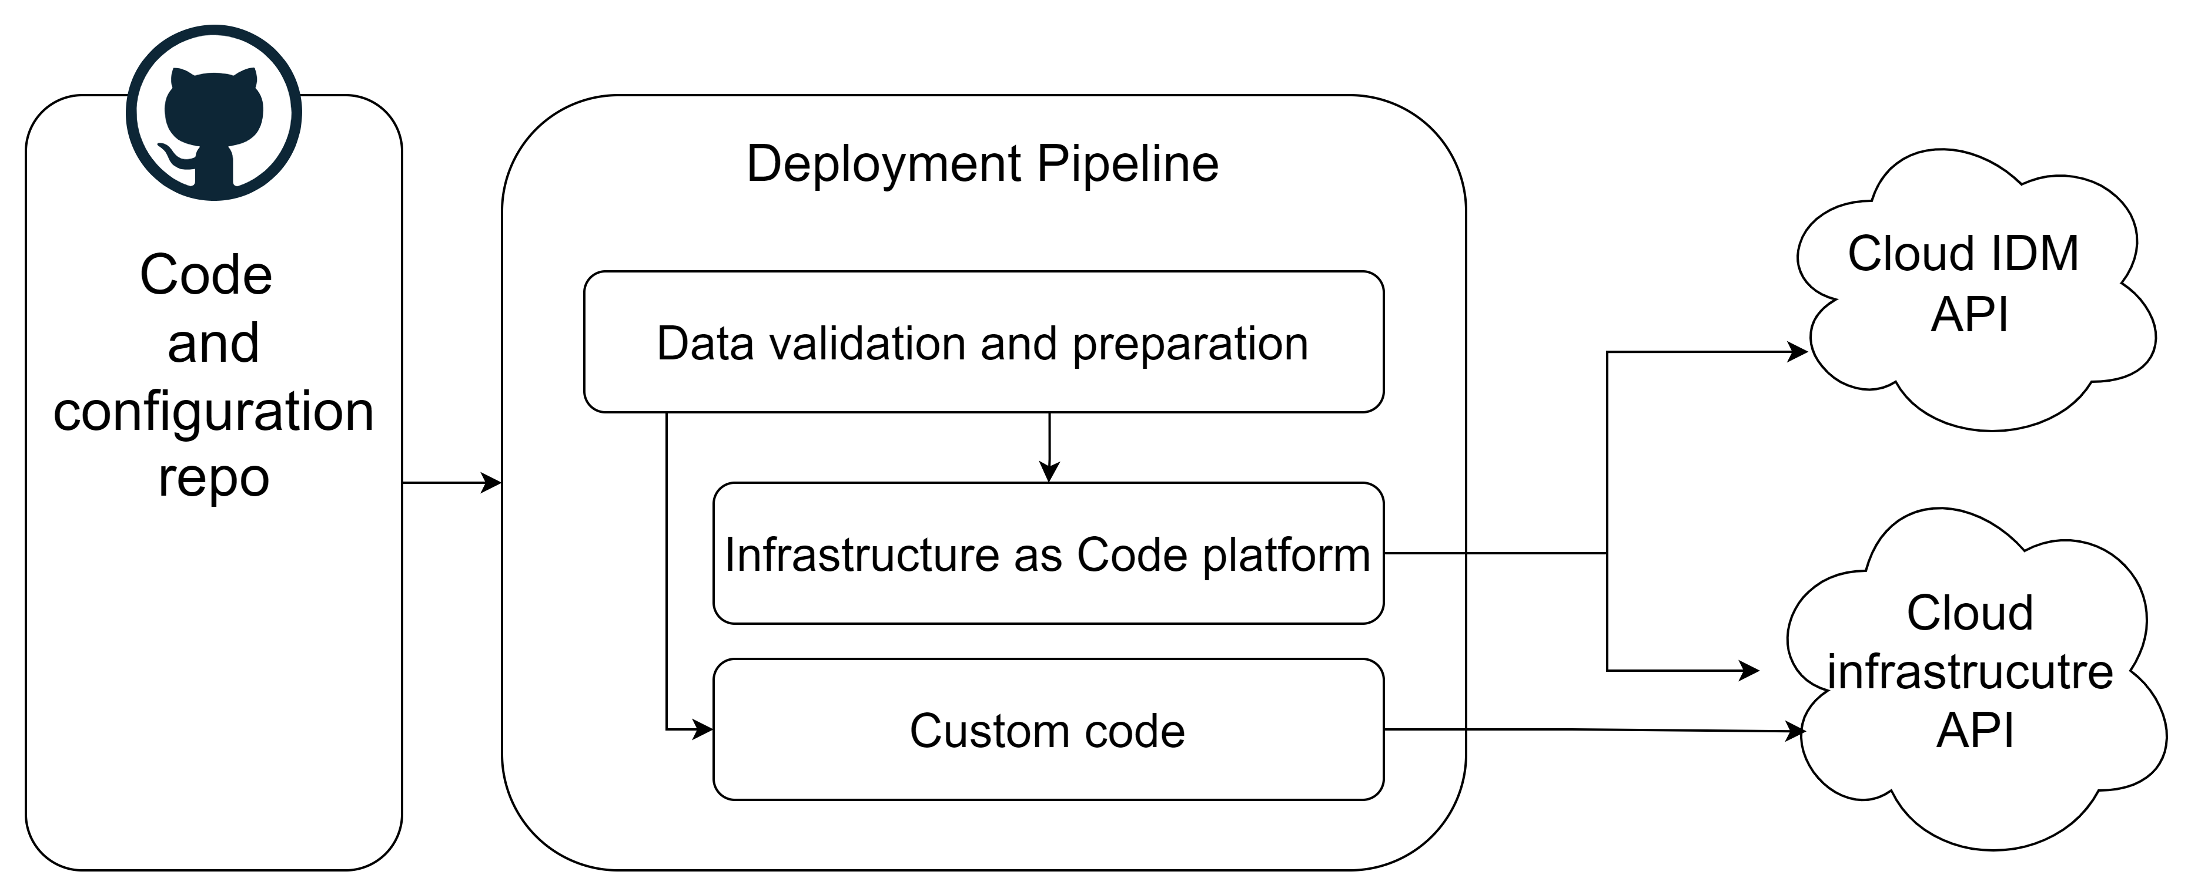

Slide 18
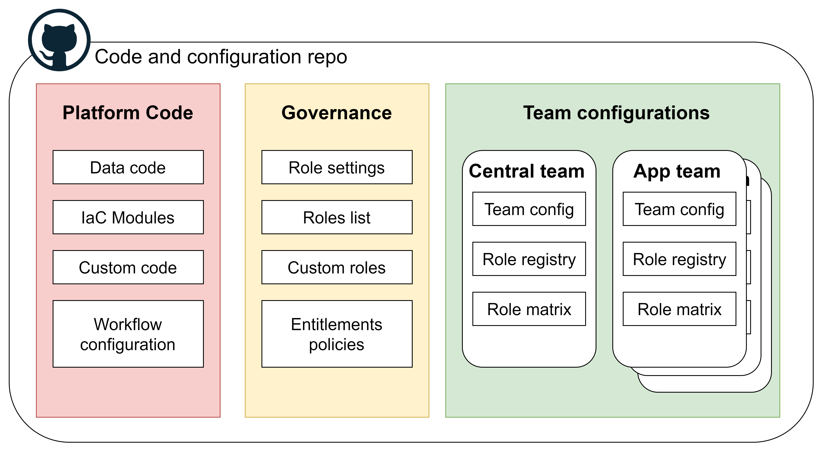
Code Approvers:
Platform team
Identity governance team
Identity governance team
+
application teams

Slide 19
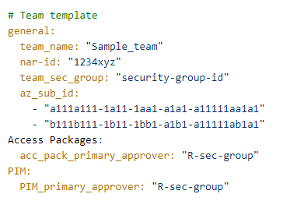
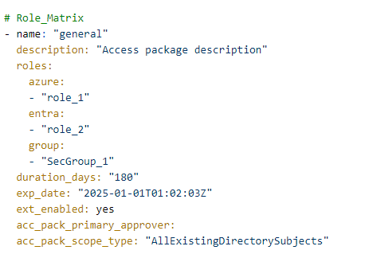
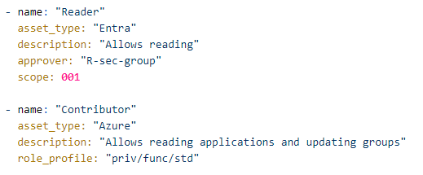
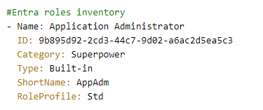

Slide 20

Recap
Role governance is not easy
Different types of identities
Different levels of privilege
Need for delegation
Sometimes you need to build your own platform
Operations define the design

Slide 21
Thank You!
Kir Bogdanov,
https://www.linkedin.com/in/kirbogd/

